Slide 1
BCSE204L Design and Analysis of Algorithms
Module-1
Greedy Techniques, Fractional Knapsack
Dr Athira K

Slide 2
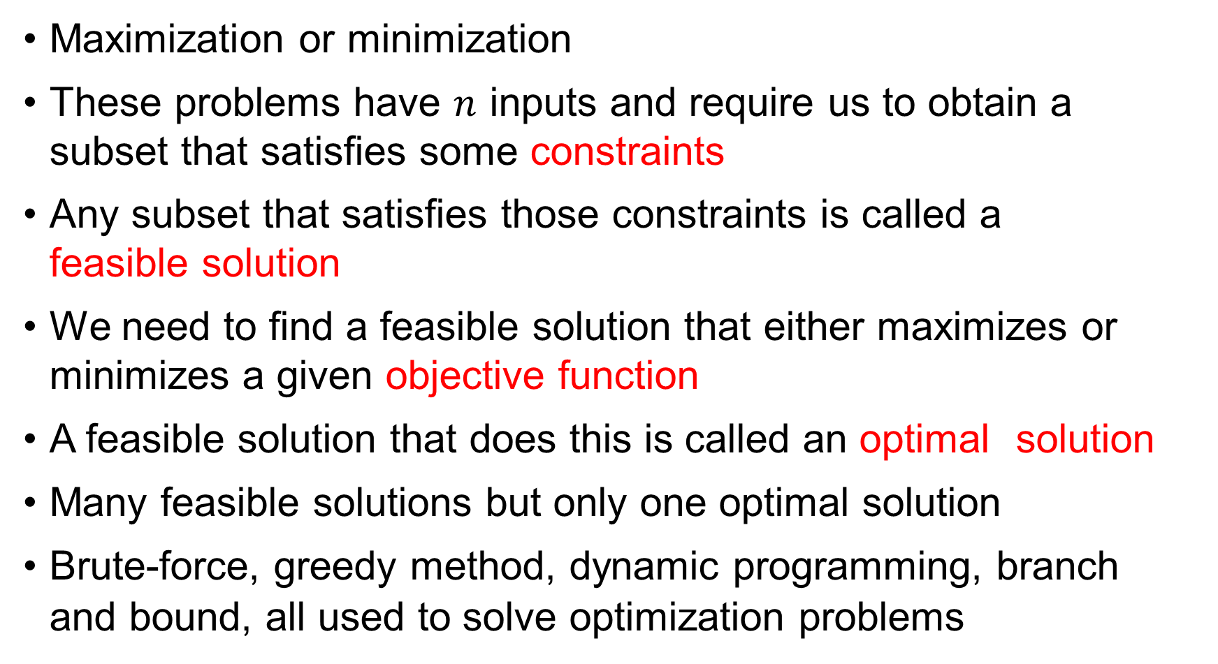
Optimization Problems
Maximization or minimization
These problems have $n$ inputs and require us to obtain a subset that satisfies some constraints
Any subset that satisfies those constraints is called a feasible solution
We need to find a feasible solution that either maximizes or minimizes a given objective function
A feasible solution that does this is called an optimal solution
Many feasible solutions but only one optimal solution
Brute-force, greedy method, dynamic programming, branch and bound, all used to solve optimization problems

Slide 3
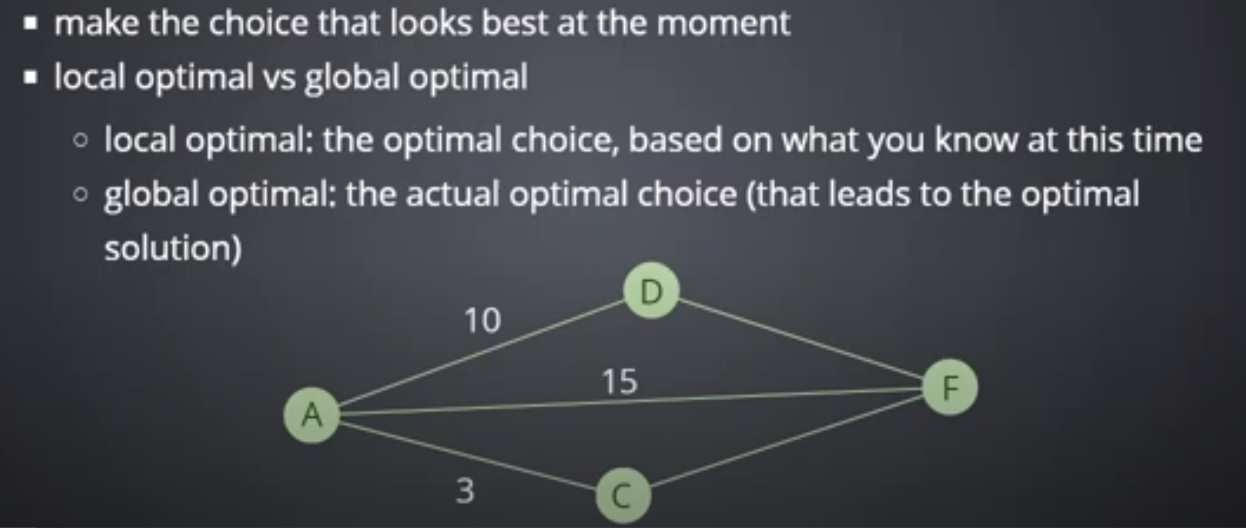
Greedy Algorithm - Features

Slide 4
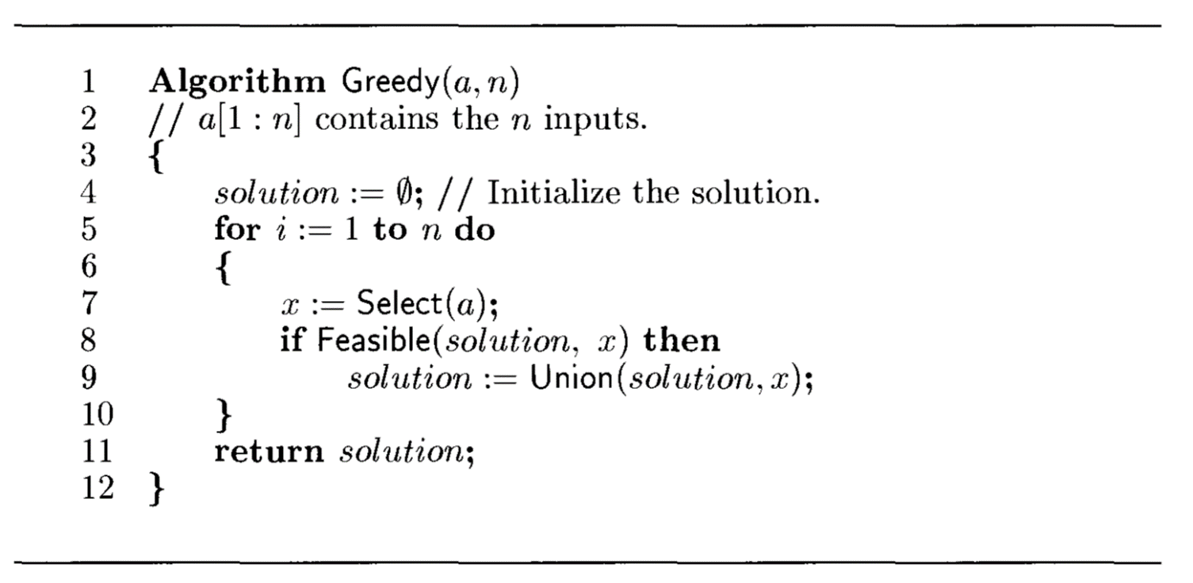
Greedy approach: working

Slide 5
Greedy Examples
Prim’s
Kruskal’s
Dijkstra’s
Fractional knapsack
Huffman coding

Slide 6
Knapsack Problem
Given a set of items, each with a weight and a profit (value), determine a subset of items to include in a collection so that the total weight is less than or equal to a given limit and the total profit is as large as possible.

Slide 7
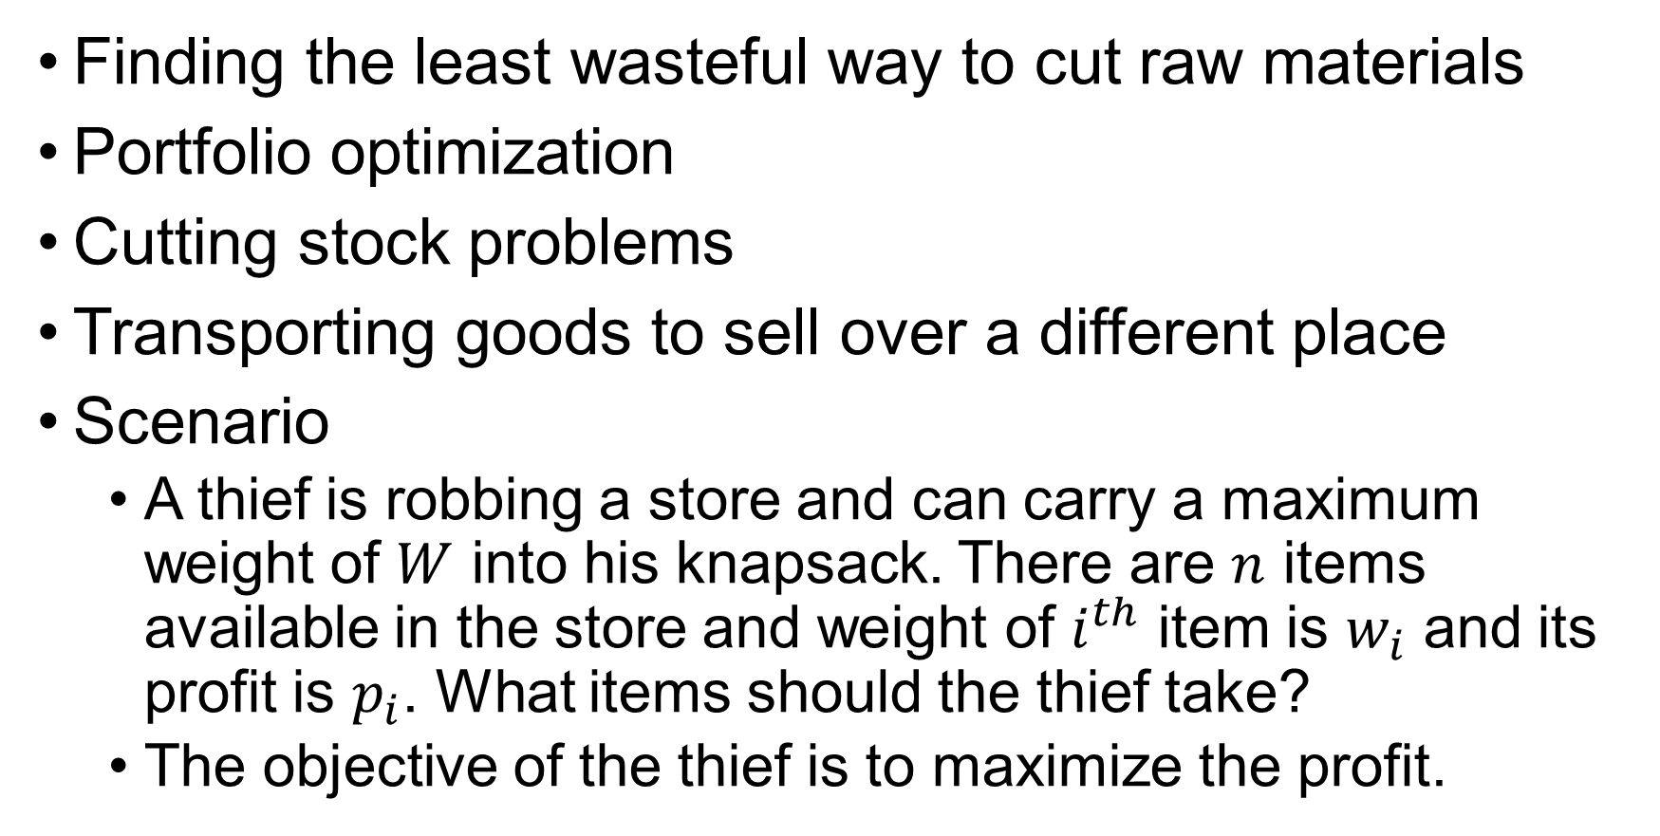
Applications
Finding the least wasteful way to cut raw materials
Portfolio optimization
Cutting stock problems
Transporting goods to sell over a different place
Scenario
A thief is robbing a store and can carry a maximum weight of $W$ into his knapsack. There are $n$ items available in the store and weight of $i^{th}$ item is $w_{i}$ and its profit is $p_{i}$. What items should the thief take?
The objective of the thief is to maximize the profit.

Slide 8
Suppose the knapsack has a capacity 4. And there are three items:
Item A with weight 3 and value 5
Item B with weight 2 and value 3
Item C with weight 2 and value 3
A has the highest value/weight ratio: 5/3, which is greater than 3/2.
Greedy approach will give profit of 5
The optimal solution contains items: B and C, in the knapsack with a total value = 6.
Greedy not suitable for 0/1 knapsack problem!!!!

Slide 9
Variations
Fractional knapsack problem
In this case, items can be broken into smaller pieces, hence the thief can select fractions of items
Greedy approach
0/1 knapsack problem
The items cannot be divided. Either take fully or drop fully
Dynamic programming approach
Here we will focus on fractional knapsack problem

Slide 10
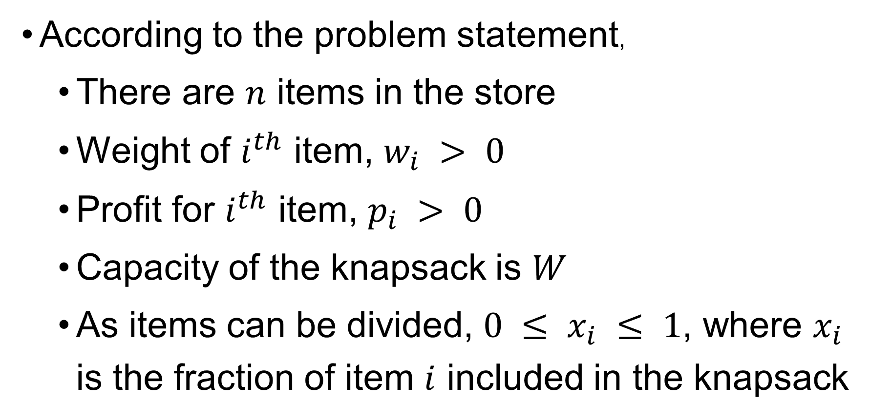
Requirements
According to the problem statement,
There are $n$ items in the store
Weight of $i^{th}$ item, $w_{i} > 0$
Profit for $i^{th}$ item, $p_{i} > 0$
Capacity of the knapsack is $W$
As items can be divided, $0 ≤ x_{i} ≤ 1$, where $x_{i}$ is the fraction of item $i$ included in the knapsack

Slide 11
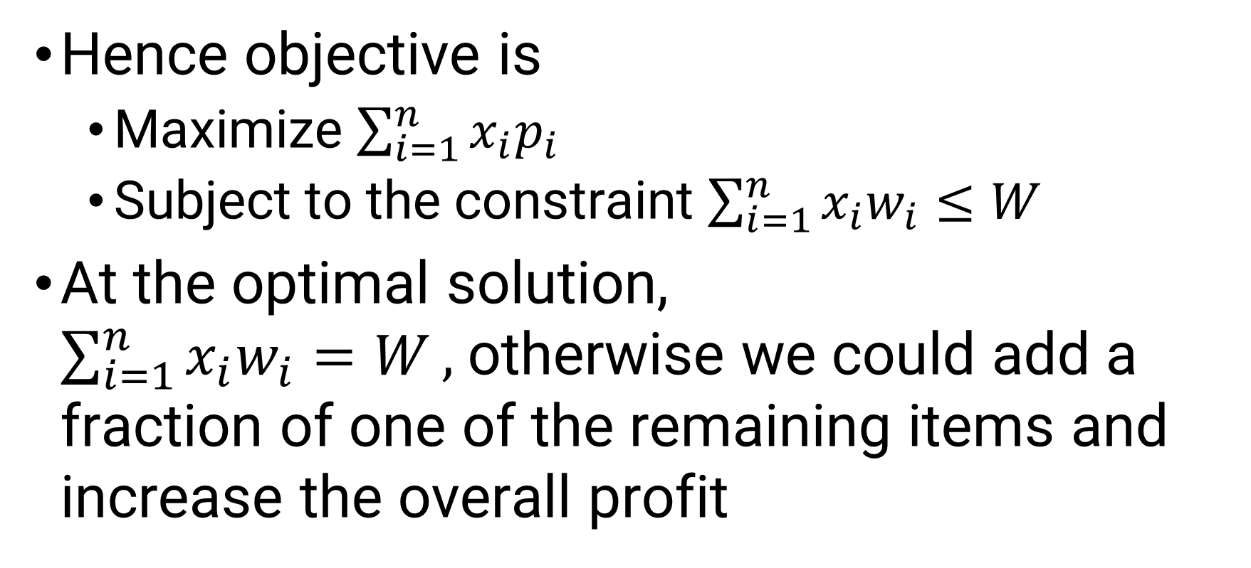
Optimizing Knapsack problem
Hence objective is
Maximize $\sum_{i=1}^{n}{x_{i}p_{i}}$
Subject to the constraint $\sum_{i=1}^{n}{x_{i}w_{i}≤W}$
At the optimal solution, $\sum_{i=1}^{n}{x_{i}w_{i}=W},$otherwise we could add a fraction of one of the remaining items and increase the overall profit

Slide 12
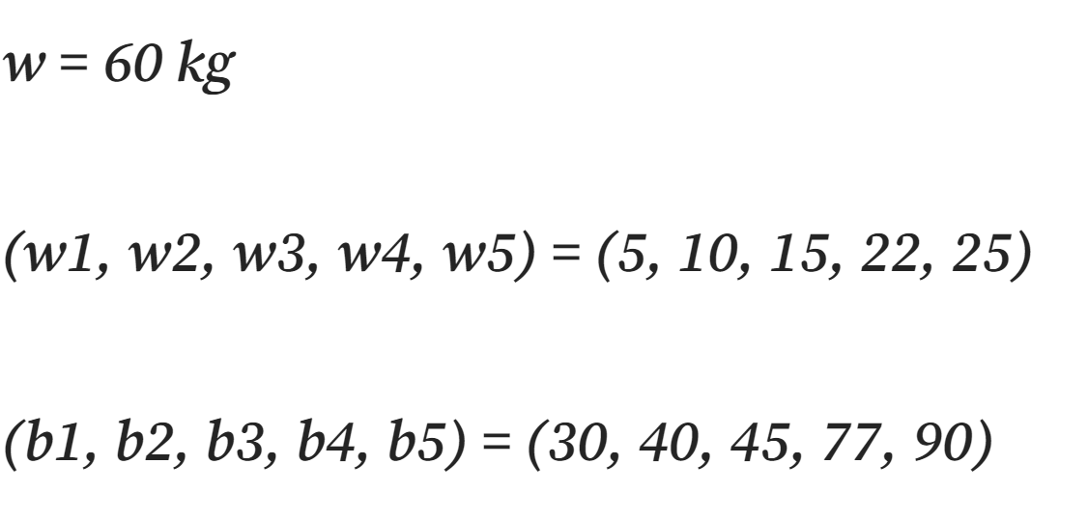

Slide 13
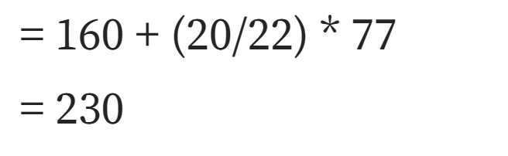

Slide 14
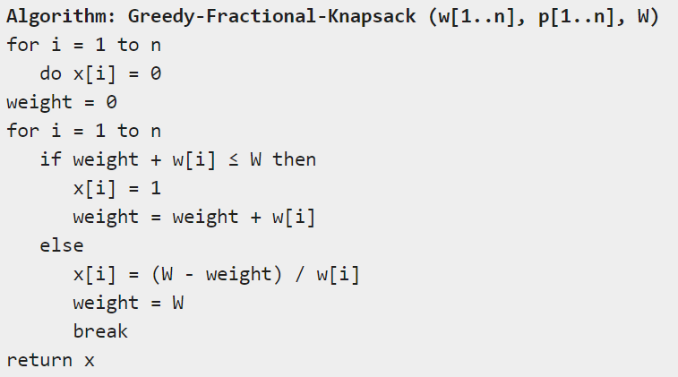
Pseudocode

Slide 15
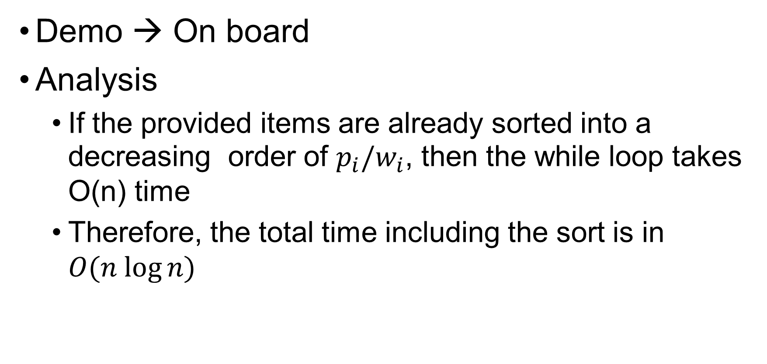
Analysis
Demo → On board
Analysis
If the provided items are already sorted into a decreasing order of $p_{i}/w_{i}$, then the while loop takes O(n) time
Therefore, the total time including the sort is in $O(n log⁡n)$

Slide 16
Lab Exercise
On Moodle

Slide 17
Thank you..!!

